Slide 1
GLOBAL INTERNET TRENDS

Slide 2
INTRODUCTION
The internet is changing the way we work, socialize, create and share information, and organize the flow of people, ideas and things around the globe. Yet the magnitude of this transformation seems underappreciated.
The world before the internet was very different from today. Over the past 40 years, there has been a steady rise in key economic development indicators across much of the developing world. GDP growth has coincided, among other things, with rapid expansion of internet connectivity, which picked up in the 1990s.
Leveraging data visualization tools like Tableau, we have analyzed various facets of internet usage.

Slide 3
DATASET
Two datasets have been used for the visualizations detailed in this project namely –
Global Internet Users – Sourced from Kaggle.
GDP of Countries – Sourced from Kaggle collected from the world bank.
These datasets were merged together in python.
The merged dataset contains 8868 data entries with 8 features.

Slide 4
FEATURES
Country name - Contains names of countries
Year - Range from 1980 to 2020
Cellular Subscription - Mobile phone subscriptions per 100 people. This number can get over 100 when the average person has more than one subscription to a mobile service.
Internet Users(%) - The share of the population that is accessing the internet for all countries of the world.
No. of Internet Users - Number of people using the Internet in every country.
Broadband Subscription - The number of fixed broadband subscriptions per 100 people. This refers to fixed subscriptions to high-speed access to the public Internet (a TCP/IP connection), at downstream speeds equal to, or greater than, 256 kbit/s.
GDP – Gross domestic product of a country.

Slide 5
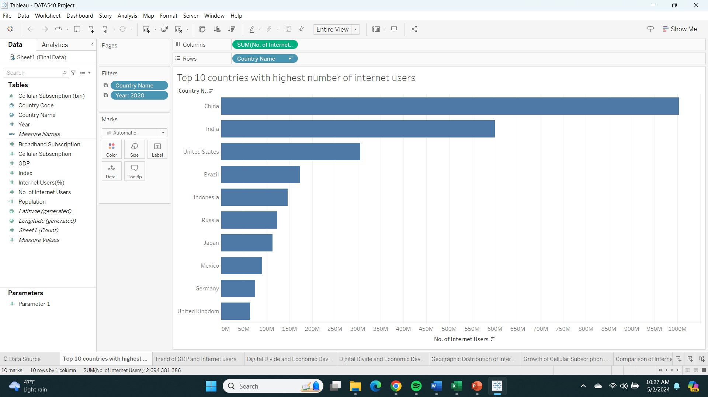
TOP 10 COUNTRIES WITH HIGHEST NUMBER OF INTERNET USERS

Slide 6
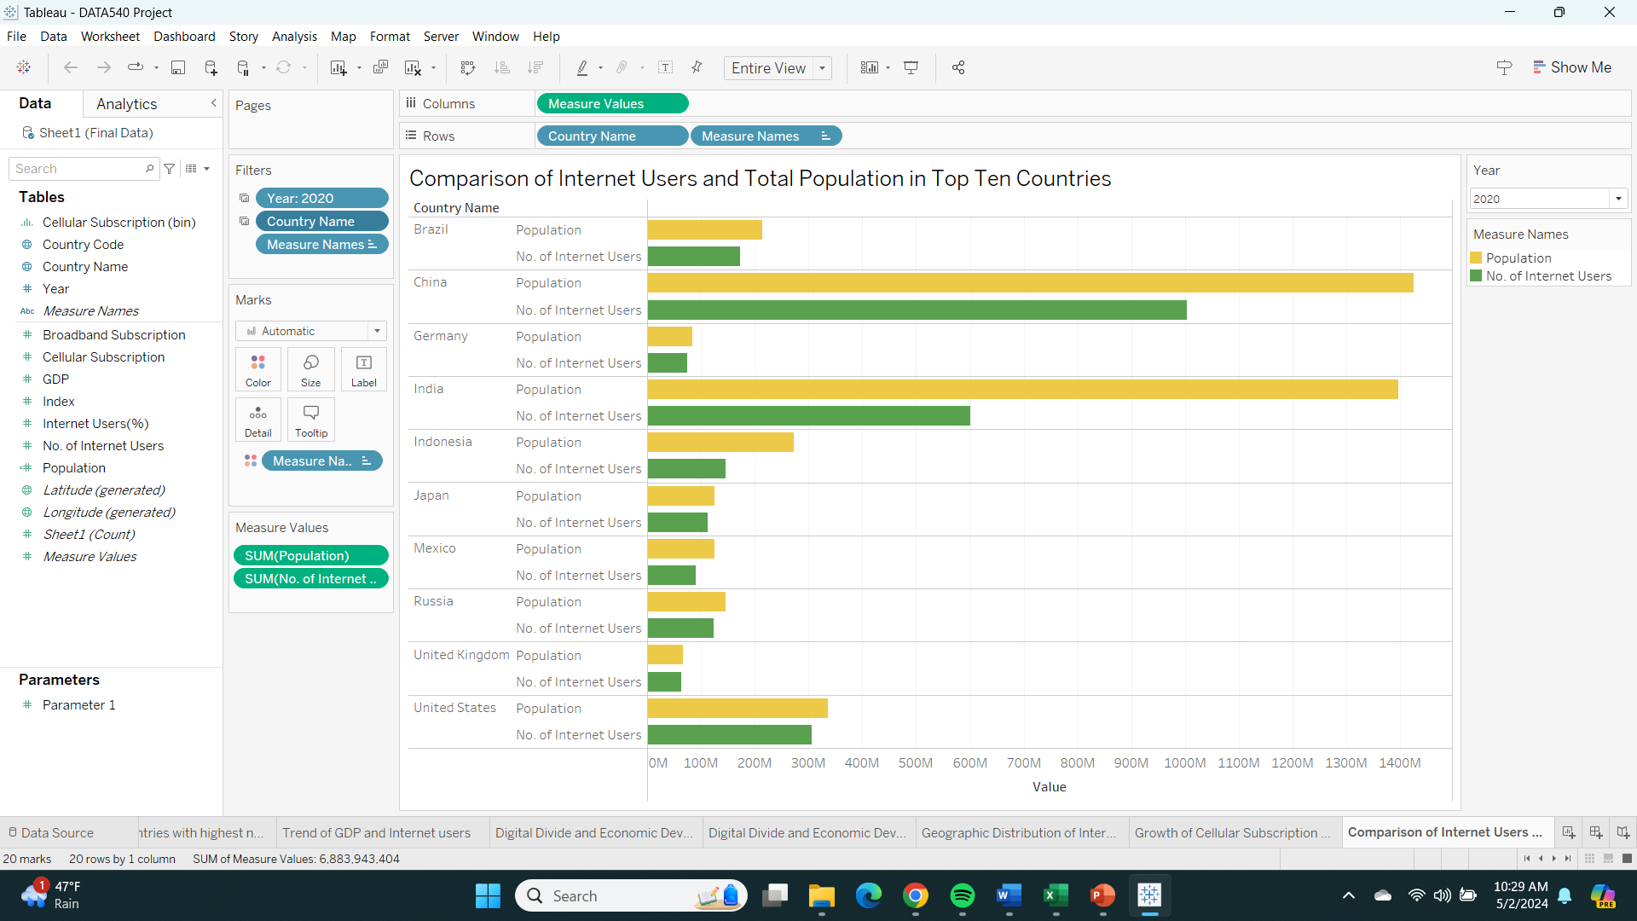
Population vs Number of Internet users

Slide 7
Referencing the plots in slide 5 and 6 we can observe that :
Even though the number of internet users in India and China are quite high as compared to other top countries there is a cause of concern in terms of access to internet as both China and India have a significant portion of their population not using or not having access to internet.
Other top countries showcase that a significant number of their total population use the internet or have access to it.
This could be caused as both these countries have high population numbers and large in area making it difficult to provide internet access to remote/rural areas.

Slide 8
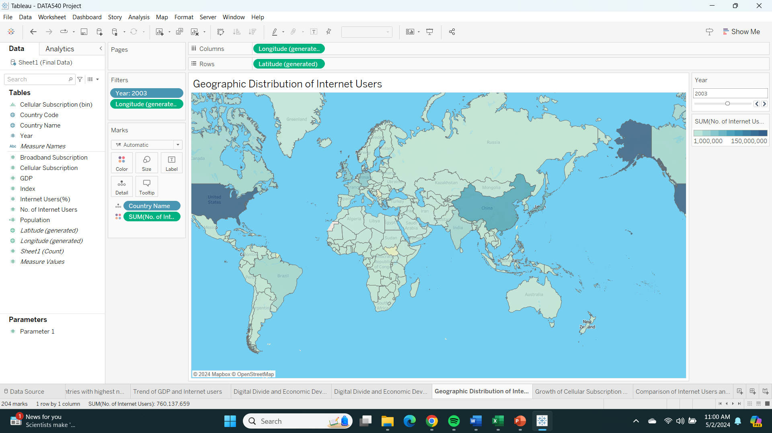
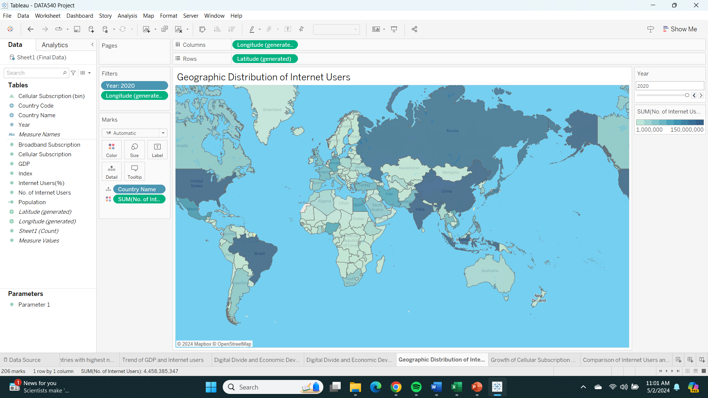
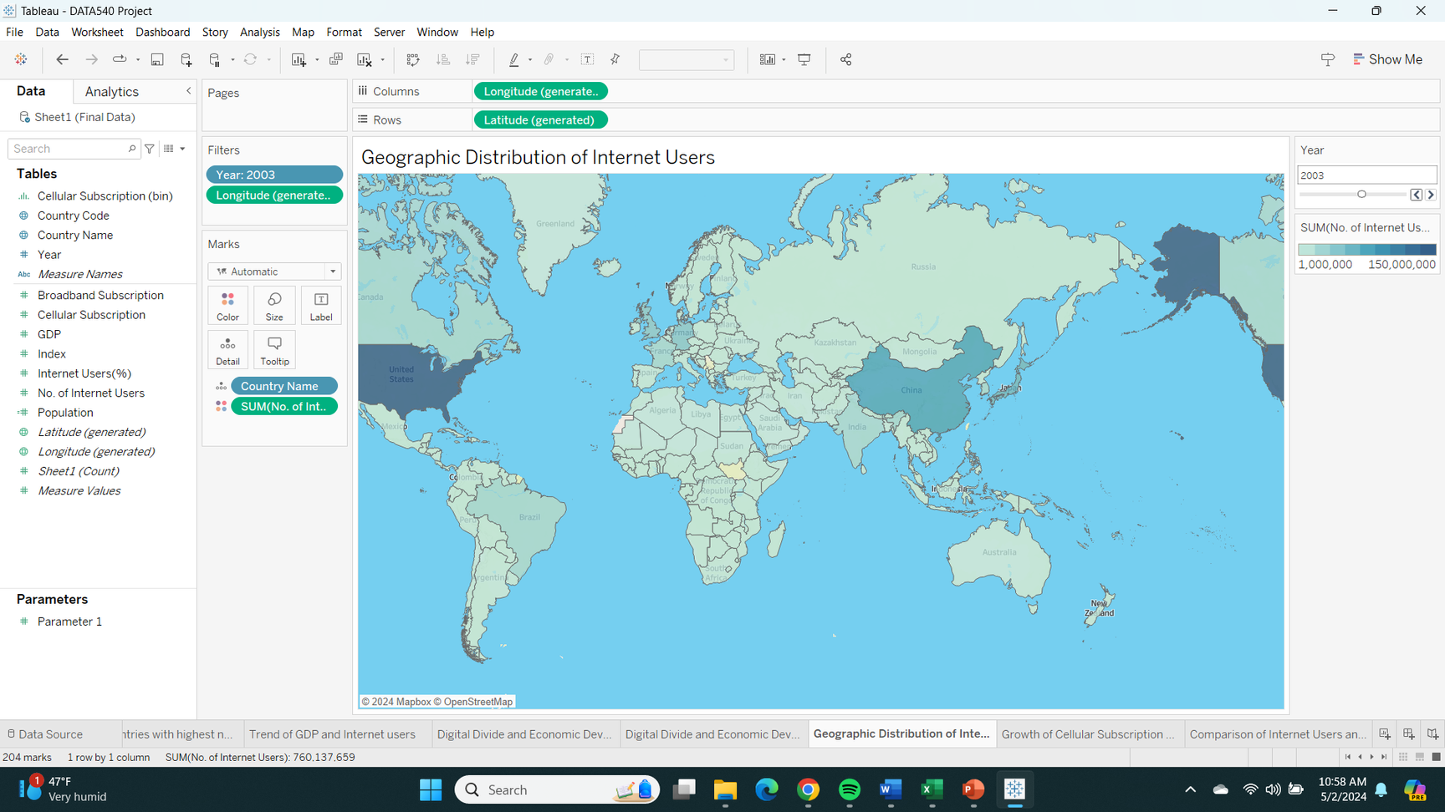

GEOGRAPHIC DISTRIBUTION OF INTERNET USERS OVER TIME
2010
2020

Slide 9
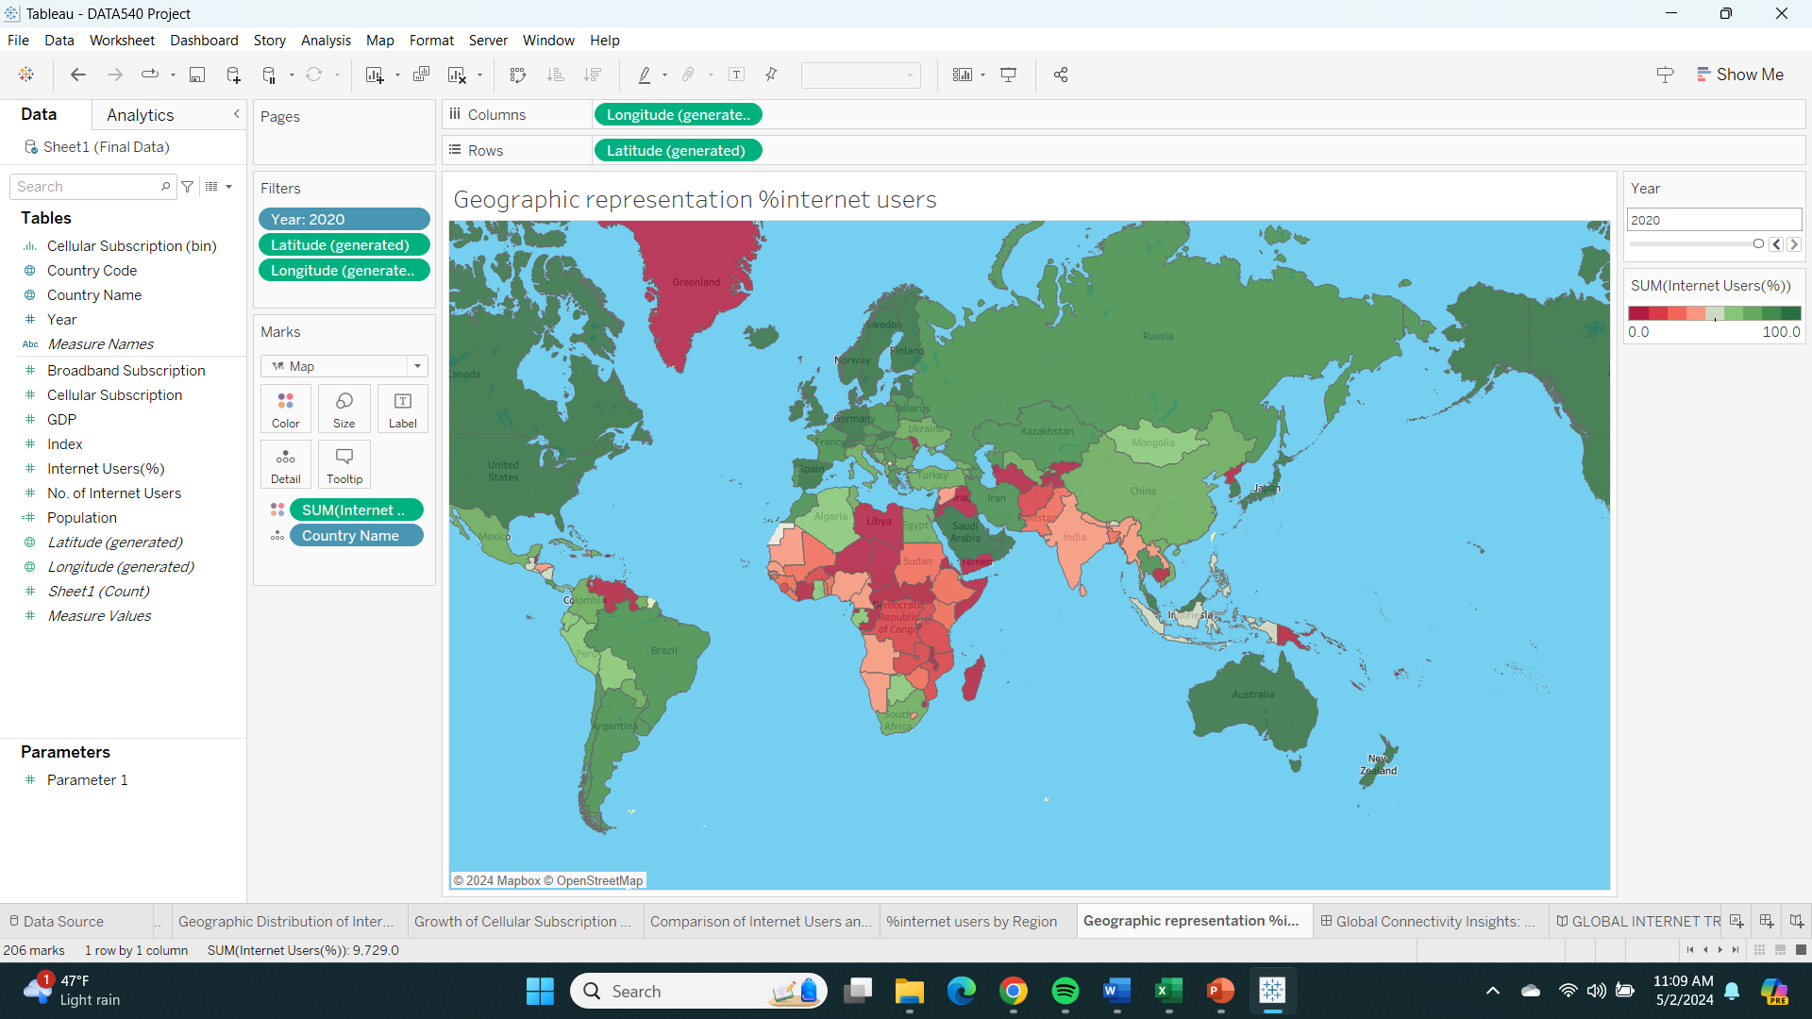
GEOGRAPHIC REPRESENTATION OF % OF INTERNET USERS IN A COUNTRY

Slide 10
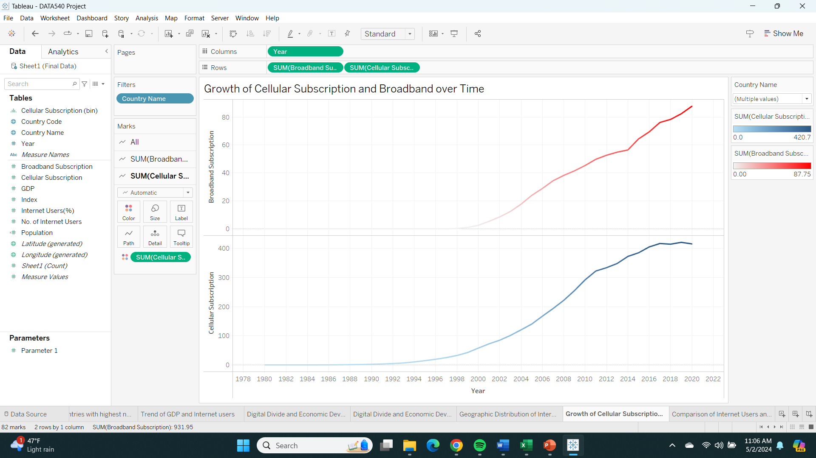
GROWTH OF CELLULAR SUBSCRIPTION AND BROADBAND OVER TIME

Slide 11
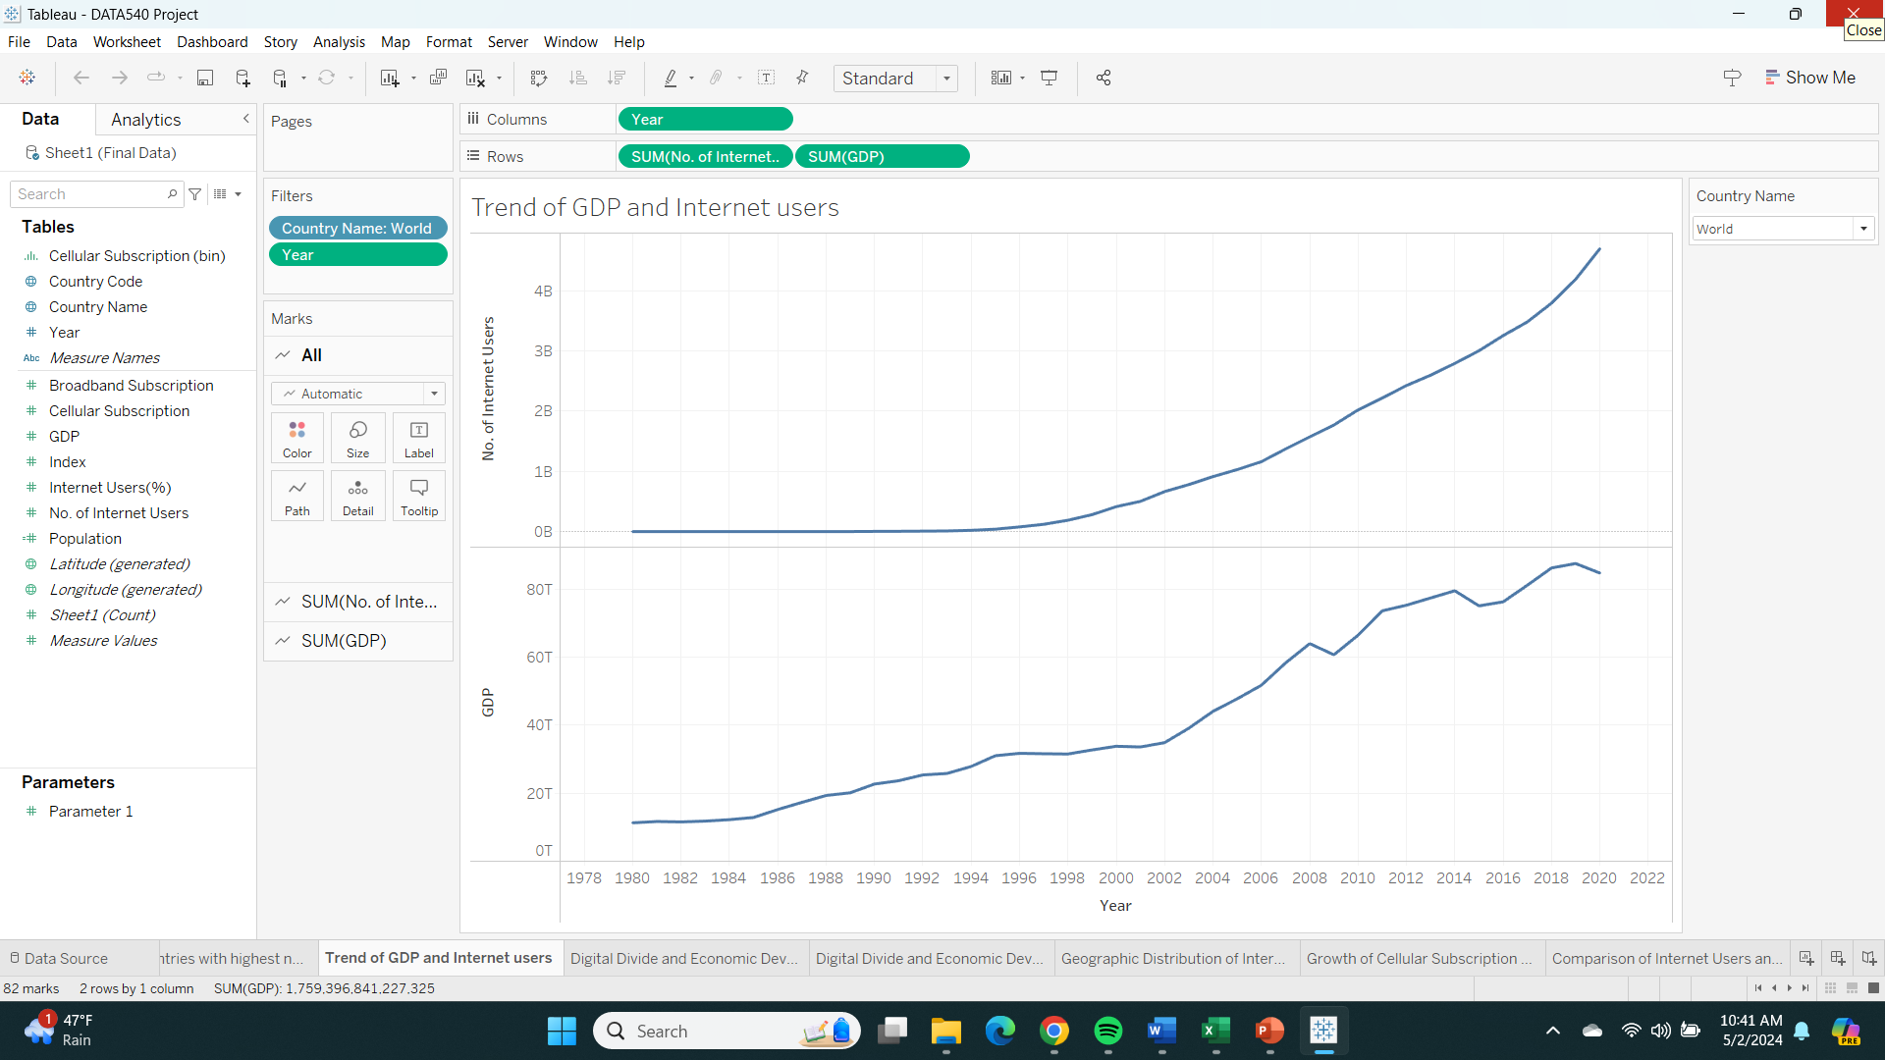
TREND OF GDP AND NUMBER OF INTERNET USERS (WORLD)
There is a rising trend for both number of internet users and GDP overtime.
And so, the correlation between these two should be investigated.

Slide 12
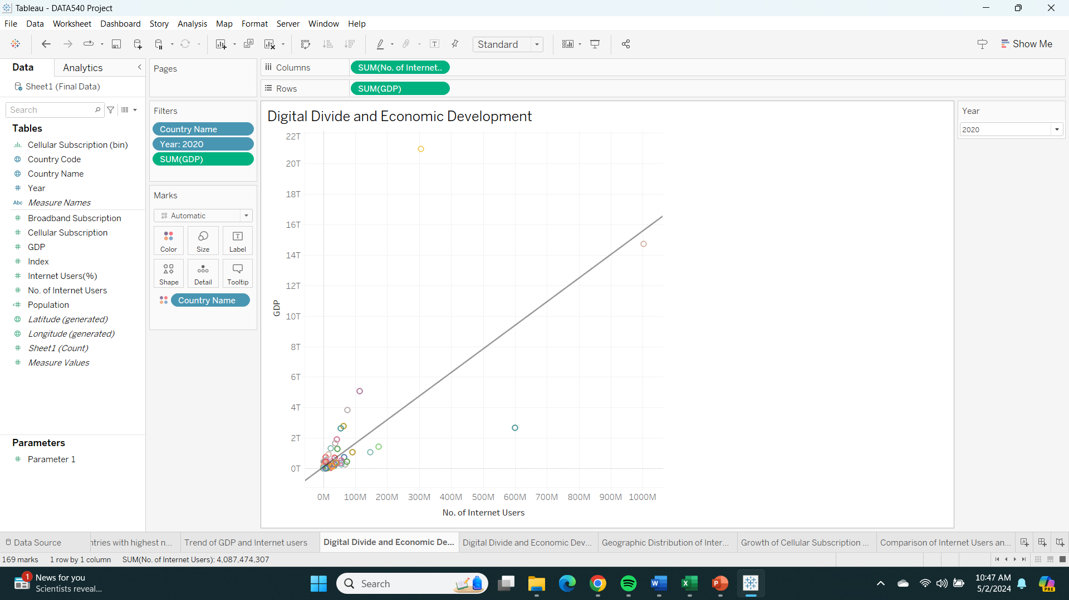
THE CORRELATION INVESTIGATION
There seems to be a rising trend line between the number of internet users and GDP.
There are two datapoints which significantly deviate from the trend line the yellow one being USA and Teal being India.
This can be explained by the high GDP and high percentage of internet users in USA as compared to India which has a high population resulting in higher number of internet users but lower percentage of internet users.

Slide 13
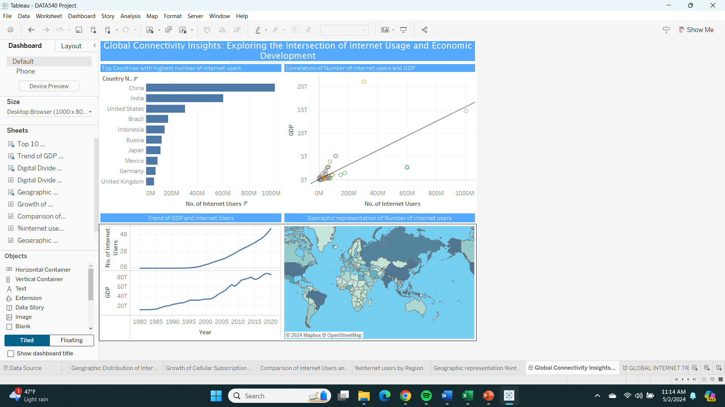
GLOBAL CONNECTIVITY INSIGHTS: EXPLORING THE INTERSECTION OF INTERNET USAGE AND ECONOMIC DEVELOPMENT

Slide 14
CONCLUSION
There does seem to be a correlation between internet usage and development of an economy.
There is scope for further research in this particular investigation being using metrics which would detail the contribution of the internet to the gdp of a country.
We should also be looking at influence of the internet in other sectors such as education (eg Literacy Rate)

Slide 15

THANK YOU

